Slide 1
Calval toolbox proposal - Philosophy
ST calvaleers produce average WSE, slope, and extent, with uncertainty, per SWORD reach/node as appropriate
From PTs, drifts, and aerial data sources
Produces dataframes- save as whatever is convenient
All intermediate products available- fully reversable
Code is on a public github (there already)
Many changes expected, so read all code with salt shaker firmly in hand for now

Slide 2
Calval toolbox proposal - Philosophy
Toolboxes should be run for each site independently, munging each PT and each drift individually
Someone who was on the water will review each run
All field names of I/O must be standard across sits
To be run on the UMass cluster via NENS access

Slide 3


Uploaded per site
UMASS cluster xml
PT/Baro
Csv/xle/.xlsx
SWORD/PLD reach WSE + uncertainty
Csv, xle, xml
GNSS
SBF /.xlsx
JPL process
SWORD node WSE + uncertainty
SBF/xml
Airphotos
raster /.xlsx
UMASS cluster
xml
Raster, xml
SWORD reach slope + uncertainty (PT)
UMASS cluster
toolbox
PODAAC
Lidar
Raster/.las /.xlsx
UMASS cluster
xml
Las, raster, xml
SWORD reach slope + uncertainty (drift)
ADCP
Mmt/pd0 /.xlsx
UMASS cluster
xml
Mmt,pd0,xml
SWORD/PLD area + uncertainty (aerial)
*we must pull the podaac files to run toolboxes so if e.g. Curtis pulled a PT to check something, we're getting exactly the same file
Shorelines
Gpx/rinex /.xlsx
UMASS cluster
xml
Gpx, rinex, xml

Slide 4
Calval toolbox proposal - Overview
I have working scripts that:
1. QA/QC and correct PT levels to passing drifts with user defined knobs
2. Correct drift levels to PT levels based on a space-time filter and SWOT obs time [see later discussion here]
3. Calculate wse within nodes*
4. Calculate wse within reaches*
5. Extract lidar wses within reaches*/nodes*
6. Calculate slope from wses
I plan on making scripts that:
7. classify aerial imagery and calculate extent within reaches*/nodes*
*I define the node and reach polygons in these scripts

Slide 5
Inputs to the toolboxes
Key files to link PTs, Drifts, lidar, airphotos in space and time from field notes at each site: On Tuesday, drift ID xxx passed PTs a,b,c
This makes the table joins trivial rather than searching through all drifts and all PTs to find those that are coincident
Drift data from Shailen
Via podaac
PT data from podaac
Via podaac
GNSS level and antenna offset corrected already
Lidar raster from NCALM
Open to processing points, but much easier to start with raster
Airphoto raster from vendor
Pre geolocated, radio/ortho corrected and etc.

Slide 6
Outputs from the toolboxes
Data frames (in whatever format you want)
Field names flexible
Data are 'tidy'
This means the tables are much larger than they would be if there were separate frames of single variables
Allows total interoperability, joins, and queries
Not 'excel style'
Can split into sub frames if desired by date, time, site, reach, node, etc.
One data frame per file
Can later join them to make a table like this
Node there is a unique set of wses per drift
ReachID | NodeID | Drift_ID | PT_ID | Date time | wse_bar | wse_sd | drift_slope | drift_slope_sd | PT_slope | PT_slope_sd | extent
…
…
…
…
…

Slide 7
Looks at a raw PT file and checks to see if either of the ‘QAQC’ or ‘flagged’ folders contain a copy of it so that we can efficiently re-run without manual checking
Joins that raw PT file to a GNSS drift based on a key to associate GNSS drifts with the PTs
Filters for GNSS data within a specified time and distance threshold of the PT set by the user for that particular river
Calculates an offset between the GNSS and the PT level
Applies those offsets to PTs by closest time- if the offset changed, split the difference
Existing code 1. QA/QC PTs with user defined knobs

Slide 8
Existing code 1. QA/QC PTs with user defined knobs
Applies any field GNSS height offset corrections
Automatically scrubs any leading or trailing out-of-water data
Makes the following checks, all based on user thresholds to be tweaked by river
GNSS standard deviation within the time/distance filter- are the GNSS data too noisy?
GNSS data points- are there enough GNSS observations to make an offset?
Offset consistency- did the PT offset change dramatically from the last time? This indicates slow settling.
Sudden shifts- are there shifts in the PT record other than at the beginning and end that indicate getting bumped?
If it passes all the tests, it places the PT with its new GNSS corrected heights in a QAQC folder
If it fails, it prints the data and adds a column with an error message that describes why it failed in a ‘flagged’ folder so a tech can look at it

Slide 9
Existing code
2. Correct drifts to PT based on a space-time filter
As hydrologists, we're somewhat leery of doing this
It assumes 'bathtub' behavior between PTs, which isn't necessarily true
This correction is only necessary for those cases where SWOT overpass is in the middle of the night or the river changes dramatically in a short period of time
Otherwise we'll be on the water more or less when SWOT is overhead
Worthy of some discussion-
What is the value of corrected drifts with large introduced uncertainty vs. relying on PTs which never need hydro corrections in cases of temporal mismatch?

Slide 10
Existing code
2. Correct drifts to PT based on SWOT time
SWOT is ~instantaneous relative to field data
The difference between the PT level when the GNSS passes it (at 1hz) and the PT level when SWOT was overhead (at 15min) forms an offset
This offset is applied dynamically within an IDW
Therefore, the drift appears to 'bend' as it gets further and further from SWOT overpass time

Slide 11
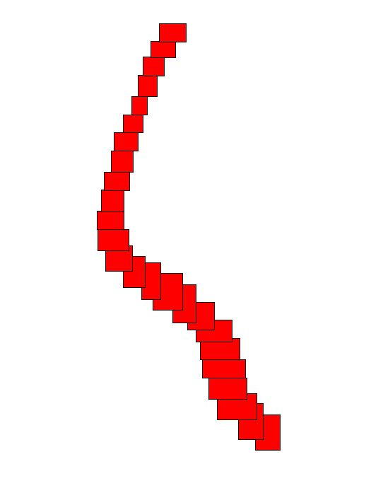
Existing code
SWORD centerline
3. Calculate slope and
wse within nodes:
Average all drift points within
Each red box
Node x,y
node length
Max width
SWORD centerline
Angles determined from SWORD centerline
It doesn't look like an orthogonal because it is bounding boxed. I could also make diamonds on axis, but this seemed better

Slide 12
Existing code
3. Calculate slope and wse within reaches:
Average all drift points within each reach
SWORD reach 3
Get mask from airphotos/Planet/S2
Get level from PT at image time and store for later comparisons
Very simple process- we have access to masks that SWOT does not
Checks to ensure that the mask we're using is appropriate to the level of the observation
SWORD reach 2
SWORD reach 1

Slide 13
Existing code
5. extract lidar wses within reaches/nodes:
Another straightforward process for us but not for SWOT
SWORD reach 3
SWORD reach 2
SWORD reach 1
Sample lidar raster
Within these polygons

Slide 14
Existing code
6. Calculate slope from wses
JPL defines slope as first to last
We must match this definition in the field
Slope:
Mean (PT(1,2,3)) - Mean (PT(12,13,14)) /
dist(PT2 <> PT 13)
PT
Field spacing depends on river
Which PTs included depends
on river
Key file indicates which PTs to use
We'll nudge PTs closer to boundaries to create this
PTs 4-11 used for reach and node wse bar
1
2
3
0.2-0.4km
…
12
13
14
Reach boundary

Slide 15
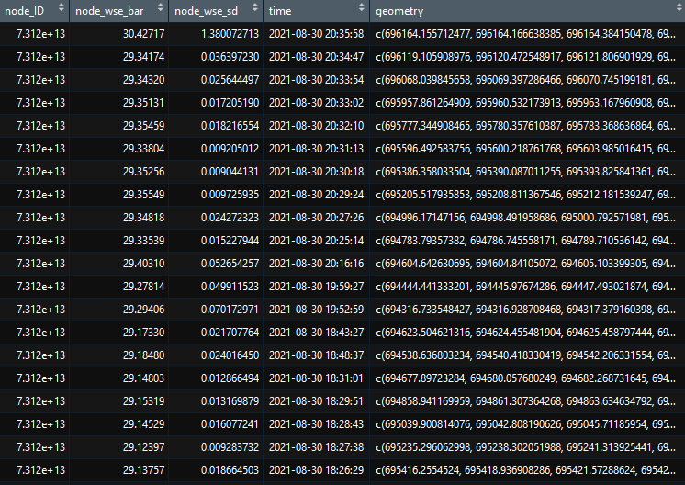
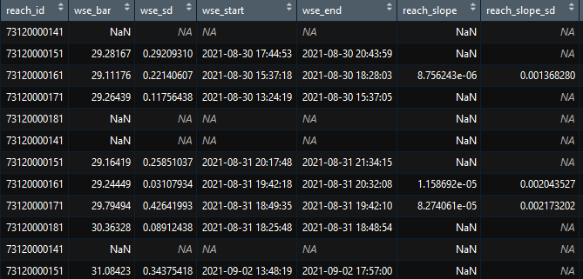
Output example: drifts
Key file makes these fully interlinked

Slide 16
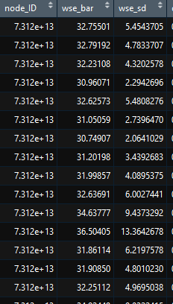
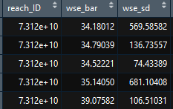
Output example: lidar
Used a polygon that grabbed lidar
from shore: demo only

